Slide 1
Political Efficacy
= a measure of citizen faith, trust, understanding, and participation in government, and the ability of government to engage the citizens and meet their needs
External Efficacy: the political system serves the needs of the people and maintains social order
Internal Efficacy: the people feel as if they have a say or can participate in the political system

Slide 2
Political Efficacy
Government
government delivers citizen needs
government responds to
citizen input
External
Efficacy
Internal
Efficacy

Slide 3
Political Efficacy
Government
government delivers citizen needs
government responds to
citizen input
Government that delivers citizen needs
But does not allow or respond to citizen input
= totalitarian / closed
= meets needs, but does not allow external efficiacy
= no dissent, not citizen feedback
External
Efficacy
Internal
Efficacy

Slide 4
Political Efficacy
Government
government delivers citizen needs
government responds to
citizen input
Optimal efficacy is build when both External & Internal Efficacies build upon and reinforce each other
External
Efficacy
Feedback Loop
Internal
Efficacy

Slide 5
Political Efficacy
implications of political efficacy:
* External efficacy does not necessarily lead to internal efficacy:
People want government services & benefits, and may not be concerned with involvement in political process if they are satisfied with the external efficacies being delivered to them. (socialist and totalitarian states can deliver services and fulfill needs without providing internal efficacies)
* Those who engage the political process as a result of high internal efficacies may be motivated by a desire for change or purely ideological pursuits:
Engagement in the political process may or may not be associated with a dissatisfaction with external efficacies, however, much engagement can be motivated by a desire to have a say in the political process out of self-interest, ideological views, or political alignments.
Question: are those who carry costs more likely to engage the political process than those who receive the benefits? (and who arranged for those benefits in the first place?)

Slide 6
Political Efficacy
implications of political efficacy (con’t):
* Pluralistic, open democracies depend upon internal efficacy:
Societies that distribute power widely better engage the citizenry, and therefore deliver or create more internal efficacy. Think Toqueville!
Certain liberties are necessary for effective internal efficacy, especially free speech, dissent, and other protections against government limits on belief and action based upon it.
* Legitimacy is related to political efficacy!

Slide 7
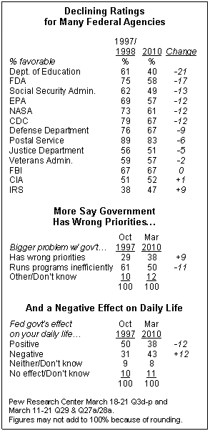
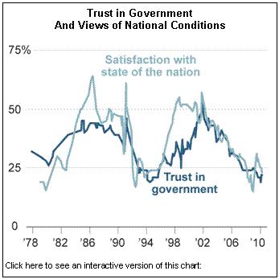
External Efficacy: the political system serves the needs, or responds to the needs, of the people
Internal Efficacy: the people feel as if they have a say or can participate in the political system
Questions:
* Has the growth of government led to more or less political efficacy in the nation?
* Can external efficacy exist without internal efficacy?
charts source: Pew

