Slide 1
Bureaucracy
&
Structures

Slide 2
Bureaucracy & Structures
bureaucracy
a system or structure for organizing and doing something

Slide 3
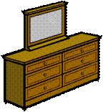
Bureaucracy & Structures
bureaucracy
a system or structure for organizing and doing something
bureaus of government:
  * Federal Bureau of Investigation
  * Bureau of Printing & Engraving
The offices and functions of the government = the government bureaucracy

Slide 4
Bureaucracy & Structures
bureaucracy
a system or structure for organizing and doing something
bureaucracies can be private, as well:
* business bureaucracy
* school or university bureaucracy

Slide 5
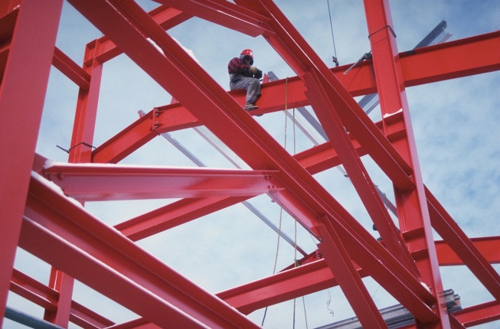
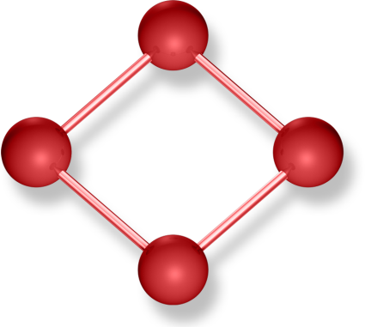
Bureaucracy & Structures
structure
rules, systems, traditions, organizations that set and guide the form of a society

Slide 6
Bureaucracy & Structures
in history...
which is more important?
people?
or
structures?

Slide 7
Bureaucracy & Structures
bureaucracies are established to make a function or service permanent, and not dependent on people

Slide 8
Bureaucracy & Structures
in bureaucracy...
  * the structure is more important than the people
  * the people fill in the offices and functions
  * the structure sets what the people do

Slide 9
Bureaucracy & Structures
but...
people create bureaucracies & structures....
= Leadership & Choices

Slide 10
Bureaucracy & Structures
which is more important?
people? or structure?
Sargon  
>> ruled by personality, didn’t make lasting structure
Hammurabi   the Code
 but...
        >> built legal structure, but didn’t make any other lasting structures
George Washington  
        >> personality shaped his nation, and he turned the presidency into an office, not a man
Barack Obama  ?
        >> personality got elected, but according to existing structures; will he make lasting change in American structures?

Slide 11
Bureaucracy & Structures
- end -

