Slide 1
Reading the DECLARATION OF INDEPENDENCE
Theories of the causes of the American revolution
* republicanism
* liberalism
* taxation
* consumerism
* Representation (direct v. virtual)
* Committee of Correspondence
* Western expansion / settlements
* French Canada entry to British domain
French Indian War (aka “Seven Years War” in Europe)

Slide 2
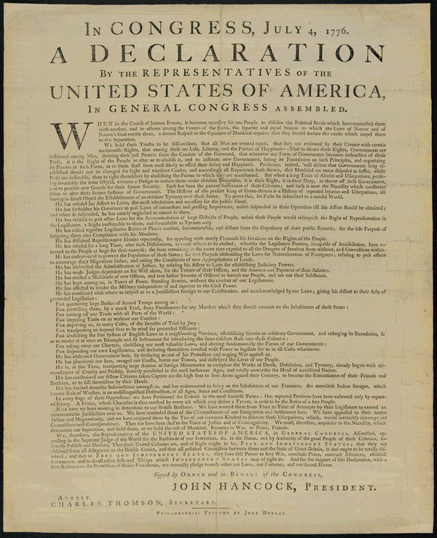
CAUSES OF THE AMERICAN REVOLUTION
REVOLUTION!!

Slide 3
CAUSES OF THE AMERICAN REVOLUTION
Theories of the causes of the American revolution:
* republicanism
* liberalism / mercantilism
* taxation
* consumerism
representation (direct v. virtual)
Committee of Correspondence
Western expansion
French-Canada
** French-Indian War **
REVOLUTION!!

Slide 4
CAUSES OF THE AMERICAN REVOLUTION
republicanism:
England corrupt ,
not-virtuous
* Americans to remake UK... only better
liberalism:
* free trade
* free thinking
consumerism:
Americans want access to other markets/ goods
* boycotts of English goods
CATALYST:
French Indian War
* Colonial default independence changed by the war
Committee of Correspondence:
* pamphlets
* propaganda
* riling up the people!
REVOLUTION!!
taxation:
England needs $$ to pay war
* England wants to control American commerce
* westward expansion and settlements
* addition of province Quebec
representation:
* English system = virtual not direct
* parliament not responding to American needs

Slide 5
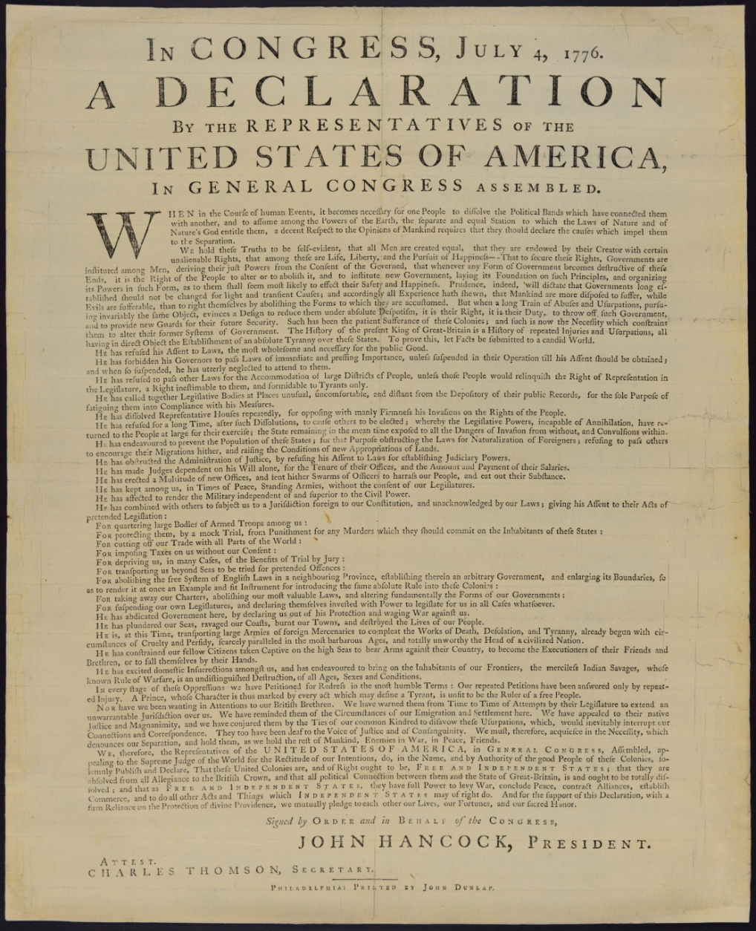
CAUSES OF THE AMERICAN REVOLUTION
republicanism:
England corrupt ,
not-virtuous
* Americans to remake UK... only better
liberalism:
* free trade
* free thinking
consumerism:
Americans want access to other markets/ goods
* boycotts of English goods
CATALYST:
French Indian War
* Colonial default independence changed by the war
Committee of Correspondence:
* pamphlets
* propaganda
* riling up the people!
add theory of self-government to the tensions and you have....
REVOLUTION!!
taxation:
England needs $$ to pay war
* England wants to control American commerce
* westward expansion and settlements
* addition of province Quebec
representation:
* English system = virtual not direct
* parliament not responding to American needs

Slide 6
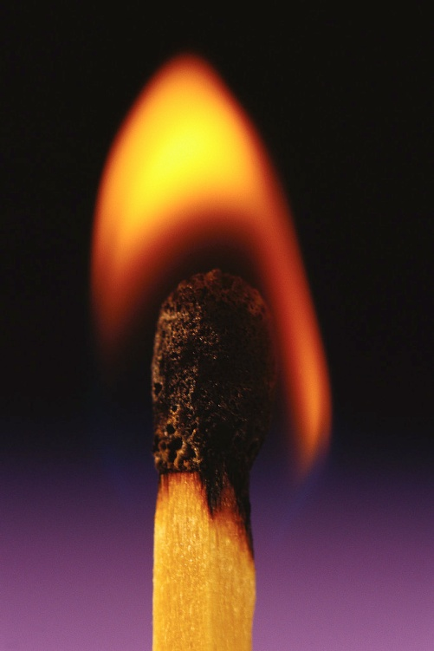
CAUSES OF THE AMERICAN REVOLUTION
republicanism:
England corrupt ,
not-virtuous
* Americans to remake UK... only better
no SINGLE one of these = revolution
the pressure on them are all from the French-Indian War 91753-1764), which led to taxes, trade restrictions, and tensions between colonists and the Royal government.
liberalism:
* free trade
* free thinking
consumerism:
Americans want access to other markets/ goods
* boycotts of English goods
REVOLUTION!!
add theory of self-government to the tensions and you have....
taxation:
England needs $$ to pay war
* England wants to control American commerce
Committee of Correspondence:
* pamphlets
* propaganda
* riling up the people!
representation:
* English system = virtual not direct
* parliament not responding to American needs

Slide 7
Reading the DECLARATION OF INDEPENDENCE
Sovereignty, Legitimacy & Authority
* pre-war local colonial governments held greater sovereign
* post-war British governance exercised greater sovereignty and authority
* Parliamentary legitimacy challenged by colonialists as colonials * Royal legitimacy challenged by colonialists
Overall tension between colonial and British policy and its exercise in colonials, especially in terms of internal & external efficacies

